Slide 1
Spring Boot Actuator -

Slide 2
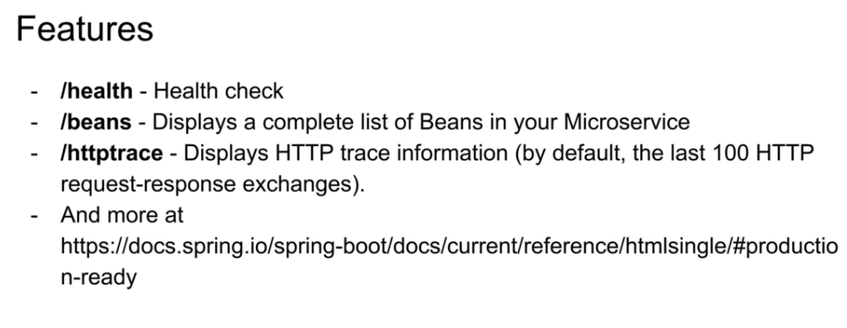

Slide 3
Spring Boot Actuator: Production-ready Features Enabling Production-ready Features <dependencies> <dependency> <groupId>org.springframework.boot</groupId> <artifactId>spring-boot-starter-actuator</artifactId> </dependency> </dependencies> Exposing Endpoints: https://docs.spring.io/spring-boot/docs/current/reference/html/production-ready-features.html#production-ready-endpoints

Slide 4
Add Spring Boot Actuator to API Gateway <dependency> <groupId>org.springframework.boot</groupId> <artifactId>spring-boot-starter-actuator</artifactId> </dependency>

Slide 5
Enable URL Spring Boot Actuator Endpoints application.properties management.endpoints.web.exposure.include=beans,health,routes,httptrace

Slide 6
Trying How It Works http://localhost:8011/actuator/health http://localhost:8011/actuator/routes http://localhost:8011/actuator/beans - JSON Formatter https://jsonformatter.curiousconcept.com/

Slide 7
Enable Actuator for Users Microservice management.endpoints.web.exposure.include=mappings How It Works http://localhost:8011/users-ws/actuator/mappings - JSON Formatter https://jsonformatter.curiousconcept.com/

